Slide 1
AP® Human Geography Unit 2: Population and Migration
Copyright © 2013 - All rights reserved - Daniel L. Eiland
AP and Advanced Placement are registered trademarks of the College Entrance Examination Board which was not involved in the production of and does not endorse this presentation.

Slide 2
Overview
Unit 2
Population
Migration

Slide 3
Part 1: Population

Slide 4
Sections
Where is Everyone?
Where has population increased?
Why is population increasing at different rates?
Overpopulation

Slide 5
Section 1: Where Is Everyone?

Slide 6
What is demography?

Slide 7
Create your own definition:
Demos (Greek for “People”) + graphe (Greek for “to describe”)

Slide 8
What is population distribution?

Slide 9
“Population distributions are descriptions of locations on the Earth’s surface where individuals or groups live.”

Slide 10
In what places on Earth do you expect to find the most people living?
What common traits might these places exhibit?

Slide 11
What is ecumene?

Slide 12
“Ecumene is the portion of the Earth’s surface occupied by permanent human settlement.”

Slide 13
Common Traits of Ecumene
Almost 90% of all people live north of the equator.
Most people live in areas close to sea level.
About two-thirds of world population is concentrated within 300 miles of the ocean.
More than half of all people live on about 5% of the land, and almost nine-tenths on less than 20%.

Slide 14
How do you measure population?

Slide 15
“You measure population by looking at Population Density; the number of people occupying an area of land.”

Slide 16
Arithmetic Density
Physiological Density
Agricultural Density
The total number of people in an area.
Population divided by Land Area
The number of people supported by a unit area of arable land.
Provides insights into the relationship between the size of a population and the availability of resources in a region.
The ratio of the number of farmers to the amount of arable land.

Slide 17
Discuss how the agricultural density of the United States may have changed over the last 200 years.

Slide 18
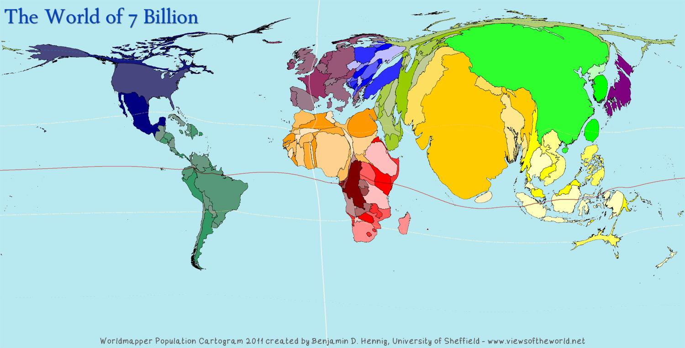
Two-thirds of the World’s Population is concentrated in four specific areas.
Notes:
Image used under Creative Commons. Created by Benjamin D. Hennig and is property of the Sasi Research Group (University of Sheffield)

Slide 19
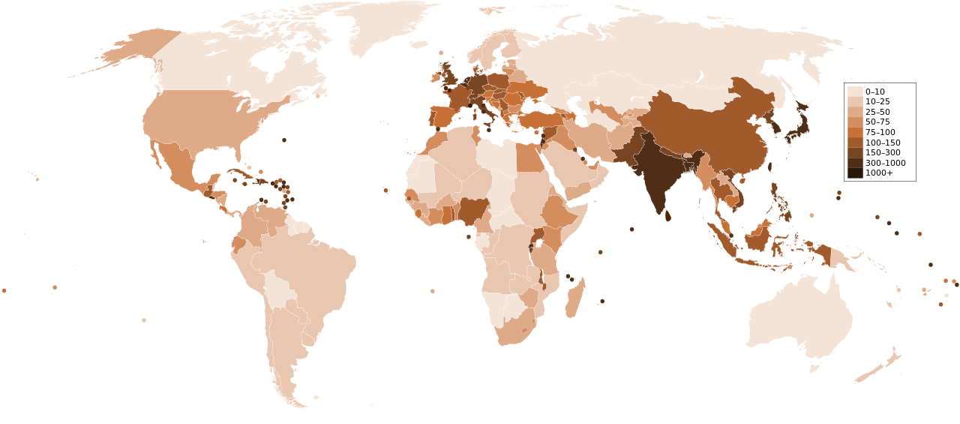
East Asia
China, Japan, the Korean Peninsula, and Taiwan
Notes:
Map used under Public Domain.

Slide 20
South Asia
India, Pakistan, Bangladesh, Sri Lanka
Notes:
Map used under Public Domain.

Slide 21
Southeast Asia
The islands of Java, Sumatra, Borneo, Papua New Guinea, Philippines, Indonesia
Notes:
Map used under Public Domain.

Slide 22
Europe
Largely concentrated in urban areas.
Notes:
Map used under Public Domain.

Slide 23
Section 2: Where has the World’s population increased?

Slide 24
How do you measure population change?

Slide 25
“You can measure population change through the Crude Birth Rate, the Crude Death Rate, and the Natural Increase Rate.”

Slide 26
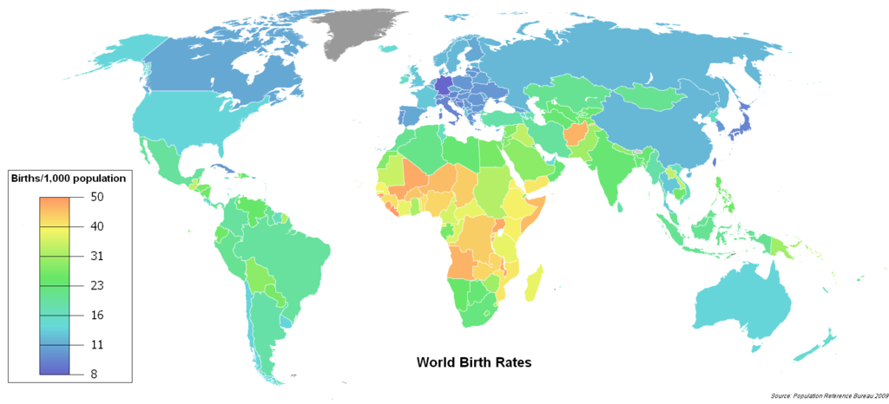
The Crude Birth Rate (CBR) is the total number of live births a year for every 1,000 people alive in the society.

Slide 27
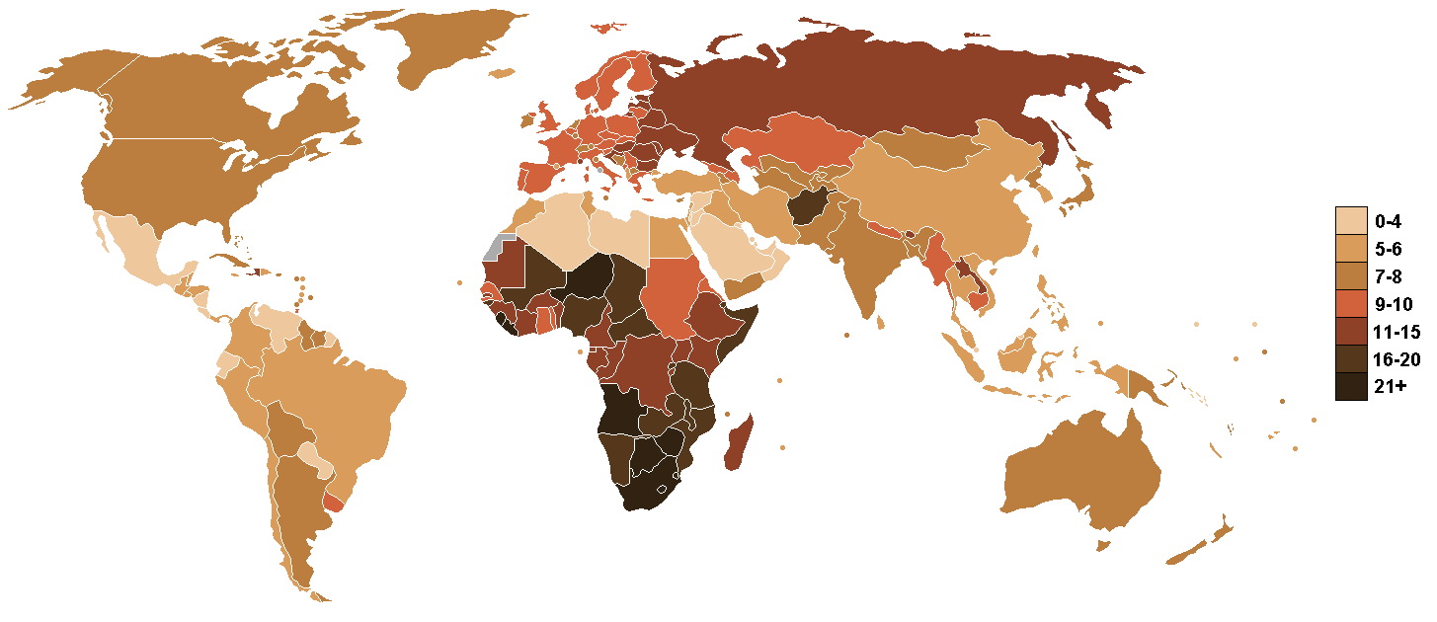
The Crude Death Rate (CDR) is the total number of deaths a year for every 1,000 people alive in the society.

Slide 28
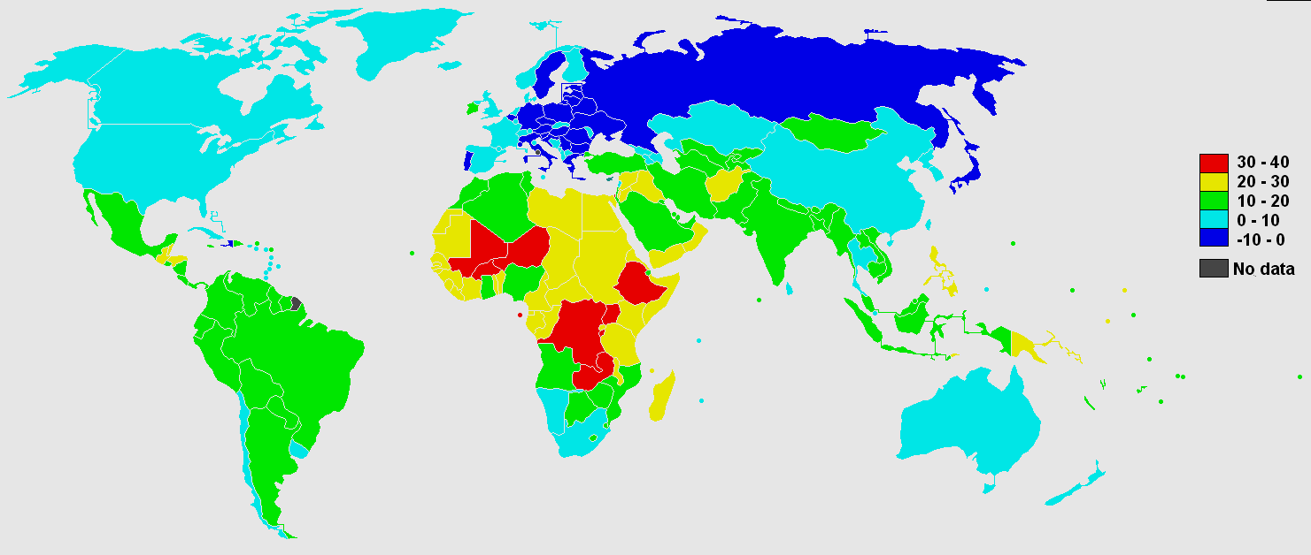
The Natural Increase Rate (NIR) is the percentage by which a population grows in a year.

Slide 29
NIR = (Crude birth rate − Crude death rate) / 10

Slide 30
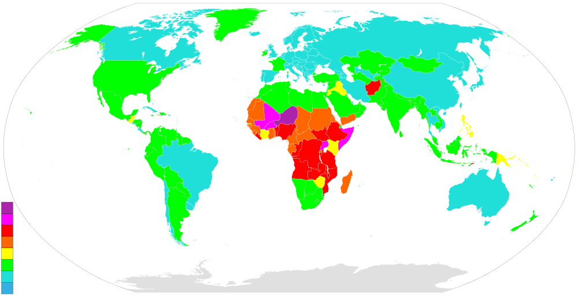
The Total Fertility Rate(TFR) is the average number of children a woman will have during her childbearing years.
Notes:
Used under Creative Commons Licensing

Slide 31
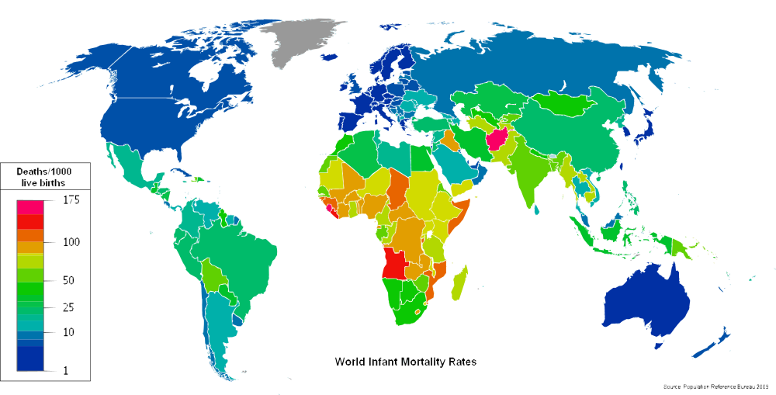
The Infant Mortality Rate (IMR) is the annual number of deaths of infants under 1 year compared with total live births.

Slide 32
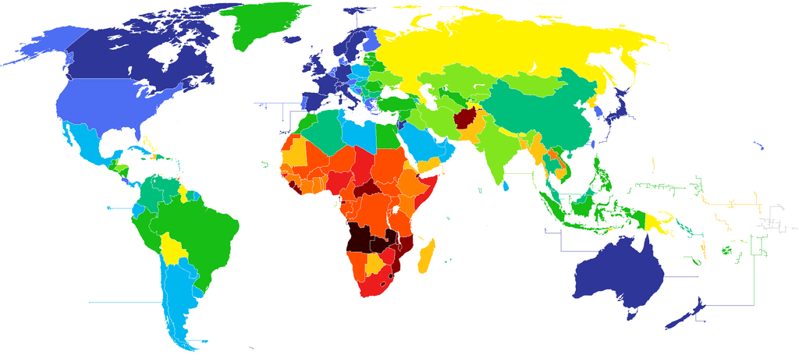
Life Expectancy measures the average number of years a newborn can expect to live at current morbidity levels.
Notes:
1) Where is Life Expectancy the highest? 2) Where is it the lowest? 3) What might attribute to these numbers? 4) Anything surprising?

Slide 33
Section 3: Why is population increasing at different rates in different places?

Slide 34
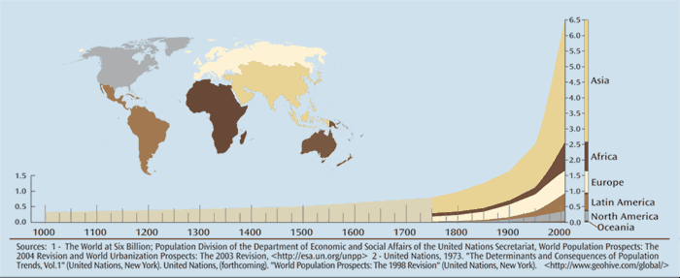
What allowed the population to grow so quickly from 1750 C.E. – 2000 C.E.?

Slide 35
What is the doubling rate?

Slide 36
“The doubling rate is the amount of time it takes to double a population.”

Slide 37
Timeline of Population Growth
Start of Human History
8,000 B.C.E.
1750 C.E.
1850 C.E.
1950s C.E.
Natural Increase close to 0
The Neolithic (Agricultural) Revolution
The Industrial Revolution
The Medical Revolution
Doubling Rate decreases because of food.
Doubling Rate decreases because of technology.
Doubling Rate decreases because less developed countries begin to get medicines.
Doubling Rate begins to decrease.

Slide 38
What are some reasons that the doubling rate began to decrease in the 1950s?

Slide 39
What is the demographic transition model?

Slide 40
“The Demographic Transition Model explains the transition from high birth and death rates to low birth and death rates as a country develops from a pre-industrial to an post-industrial economic system.

Slide 41
Stage 1: Low Population Growth
Stage 2: High Population Growth
Stage 3: Moderate Population Growth
Stage 4: Low Population Growth
Stage 5: Declining Population Growth

Slide 42
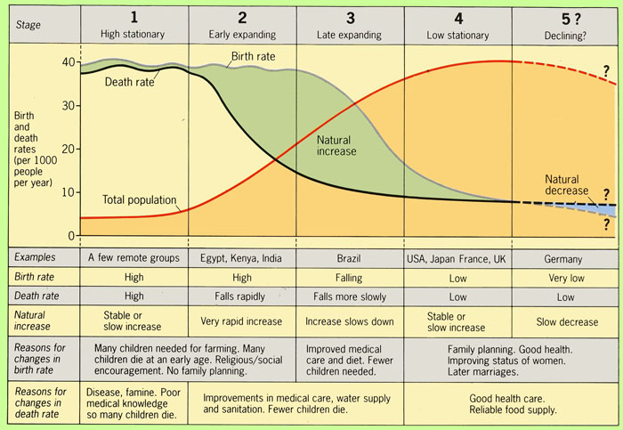

Slide 43
What is a population pyramid?

Slide 44
“A population pyramid is a graphical illustration that shows the distribution of various age groups as well as the sex ratio, the number of males per hundred females and the dependency ratio, the number of people who are too old or too young to work.

Slide 45
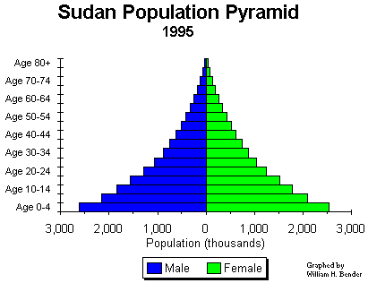
What are some population characteristics of Sudan’s population? What does this tell you about the country?

Slide 46
Stage 1: Low Growth
People depended on hunting and gathering for food.
Most of human history spent during this stage.
The NIR is essentially zero.
There is no country still in stage 1.

Slide 47
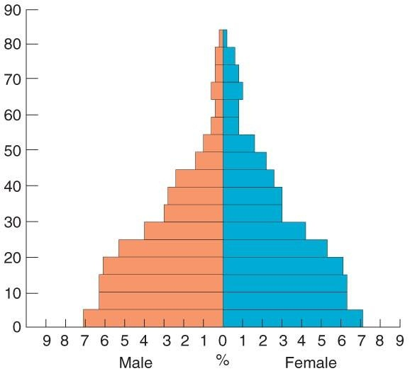
Stage 2: High Growth
Brought about by the Industrial Revolution.
CDR Plummets while the CBR remains the same as in stage 1.
Allowed to spread to LDRs by the medical revolution (20th century)
Notes:
Cape Verde

Slide 48
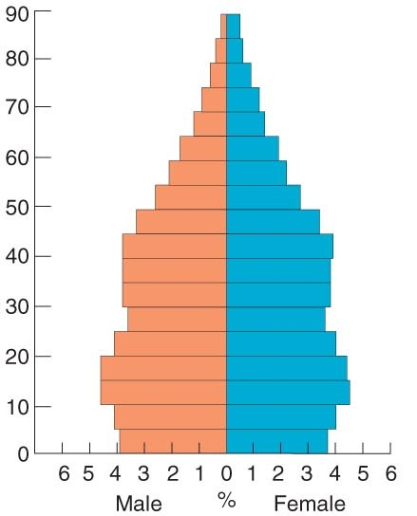
Stage 3: Moderate Growth
Brought about by cultural changes.
Characterized by a sudden drop in the CBR.
There is still growth but not as fast as in Stage 2
Notes:
Chile

Slide 49
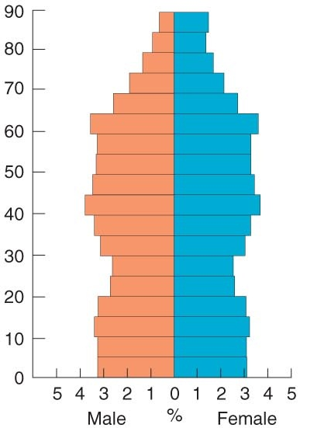
Stage 4: Declining Growth
The CBR = CDR
Brought about by an aging population, education, and family planning
Zero Population Growth
Low TFR
Notes:
Denmark

Slide 50
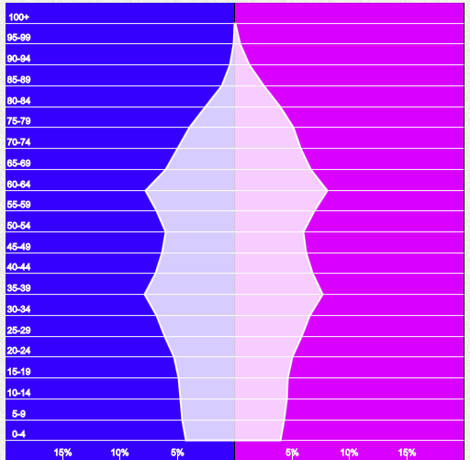
Stage 5: Negative Growth
CDR > CBR because of an aging population.
NIR is less than Zero.
Much of Europe is entering this stage.
Notes:
Japan

Slide 51
The following 5 slides are population pyramids of different areas on earth. Determine what stage they are in by how they look.

Slide 52
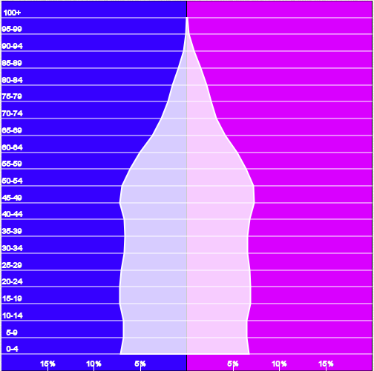
The United States of America

Slide 53
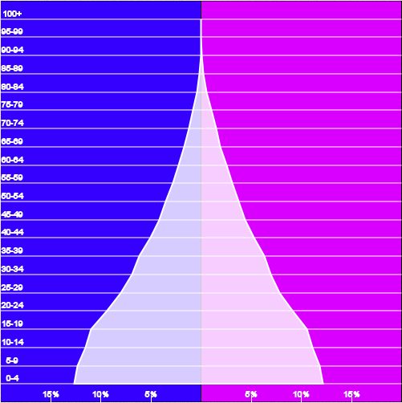
Bolivia

Slide 54
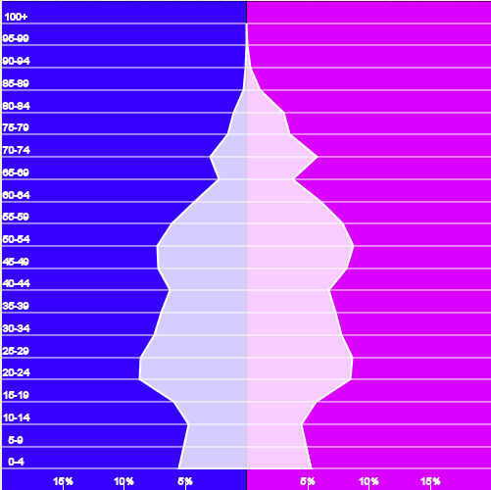
The Russian Federation

Slide 55
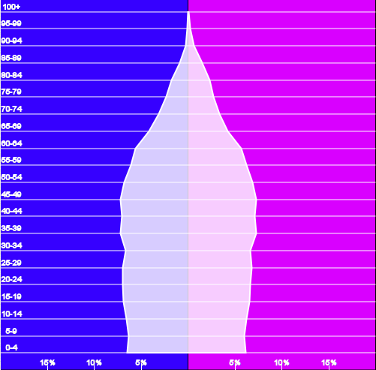
Australia

Slide 56
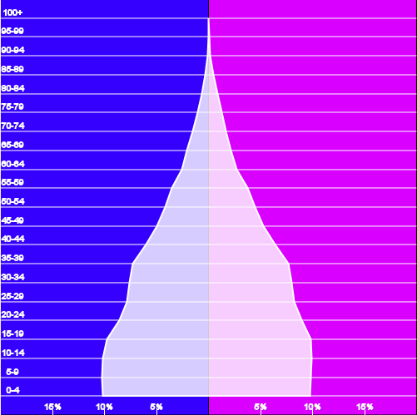
Central America

Slide 57
Predicting Growth
To determine how much a population will grow, geographers use the demographic accounting equation:
$$P\left(t+1\right)=P\left(t\right)+B\left(t, t+1\right)−D \left(t,t+1\right)+I \left(t,t+1\right)−E \left(t,t+1\right)$$
Where
P = Population, B = Births, D = Deaths,
I = Immigration, E = Emigration, t = Time Now, t + 1 = some time in the future

Slide 58
What affects population growth?
Economic Development
Education
Gender Empowerment
Healthcare
Cultural Traditions
Public Policy

Slide 59
What is the Epidemiologic Transition Model?

Slide 60
“The Epidemiologic Transition Model focuses on distinctive causes of death in each stage of the demographic transition.”

Slide 61
Stage 1
Stage 2
Stage 3
Stage 4
The stage of Pestilence and Famine
Example: The Black Death
The stage of receding Pandemics
Example: Cholera
The stage of degenerative and human-created diseases
Examples: Cancer and Cardiovascular Disease
The stage of delayed degenerative diseases
Example: Cancer and disease is slowed or stopped by medical advances.
Stage 5 (Possible)
Reemergence of infectious and parasitic diseases.
Reasons: Evolution, Poverty, Improved Travel

Slide 62
Section 4: Overpopulation and Population Control

Slide 63
Are we becoming overpopulated?

Slide 64
How would you define overpopulation?

Slide 65
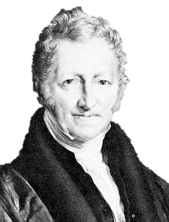
My theory is that population will eventually outpace food production. While population increases geometrically, food supply increases arithmetically.
Thomas Malthus

Slide 66
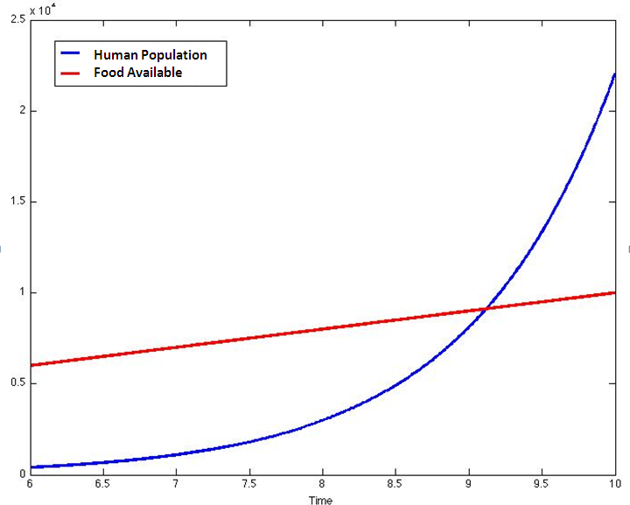
Thomas Malthus’ Theory

Slide 67
Malthus Supporters (neo-Malthusians) Argue:
The growth of less developed countries are outstripping even Malthus’ predictions.
World population is not just stripping food but a lot of other resources as well.
To fix the problem continue programs for population limitation such as birth control and family planning.

Slide 68
Malthus Critics Argue:
Malthus’ theory is based on a belief that the increase in the world’s food supply is fixed rather than expanding.
An increase in technology and genetic food production has increased the amount of available food.
A larger population stimulates economic growth to produce greater resources.

Slide 69
Who is right? The Neo-Malthusians or Malthus’ Critics?

Slide 70
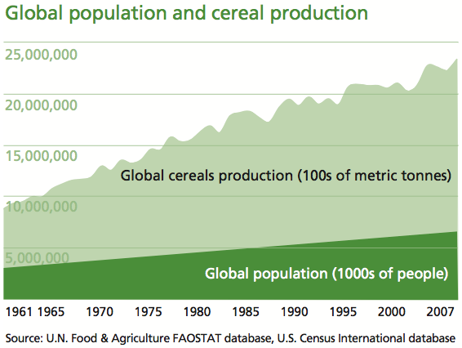
Food is increasing more rapidly than predicted by Malthus.

Slide 71
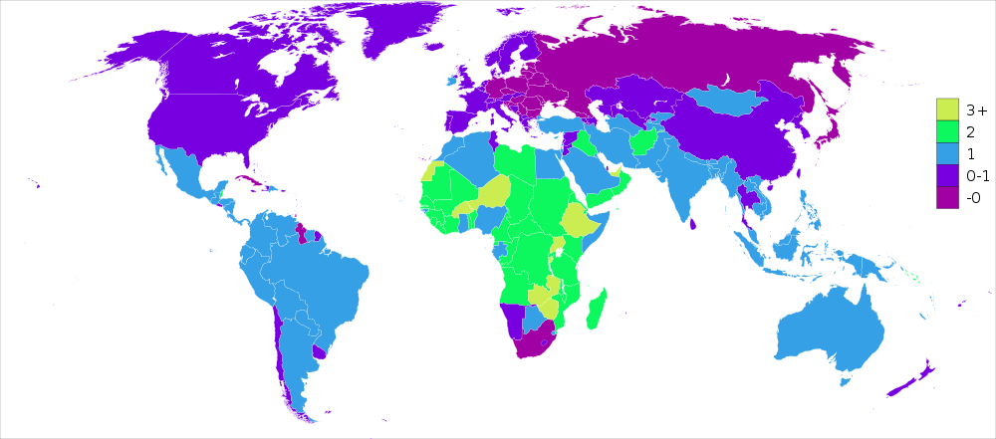
Birth Rates are declining and the NIR is dropping.

Slide 72
Explain the Following Quote:
“World food production capacity is not (yet) the problem. . . Rather, the ongoing quandary is the distribution of that food and the ability of poorer nations to purchase and allocate it to their people.”
Notes:
Taken From http://deltafarmpress.com/government/food-supply-vs-population-malthus-200-years-later

Slide 73
Why are birth rates declining?

Slide 74
Population Growth Decline
Contraceptive Use
Education
Government Policy
Women’s Rights

Slide 75
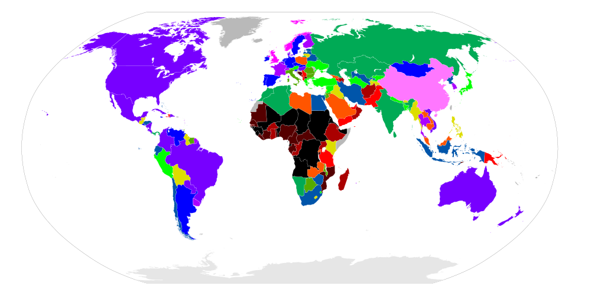
Percentage of Women using Modern Day Contraceptive Methods

Slide 76
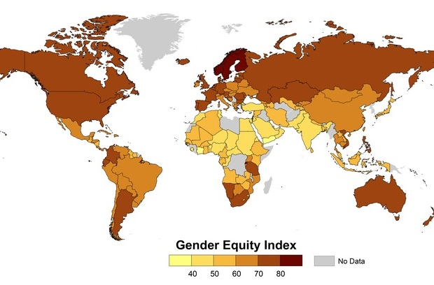
The Gender Equity Index shows the disparity between the rights of men and women.

Slide 77
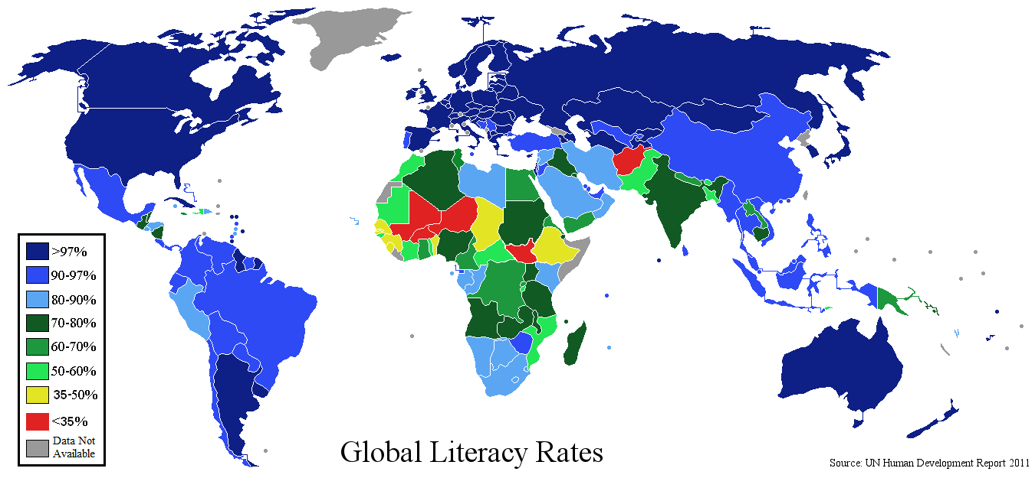
There is a link between education levels and the number of children had per family.

Slide 78
Discuss: Do you think that we will ever reach a point of zero population growth worldwide? Why or why not.

Slide 79
What is the difference between expansive and restrictive population policies??

Slide 80
“Expansive population policies are governmental policies that seek to increase the rate of natural increase while Restrictive population policies seek to reduce the rate of natural increase.”

Slide 81
A Case for an Expansive Population Policy: The Russian Federation

Slide 82
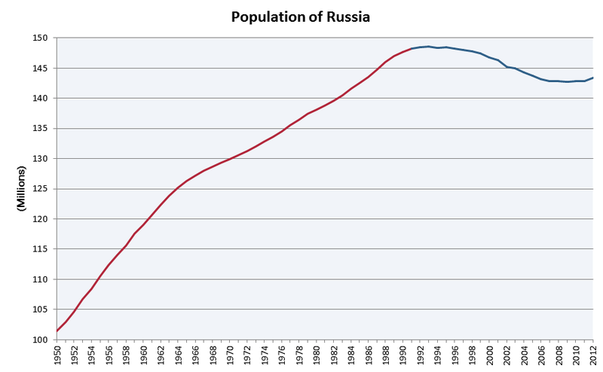
What has happened to Russia’s population since the 1990s?

Slide 83
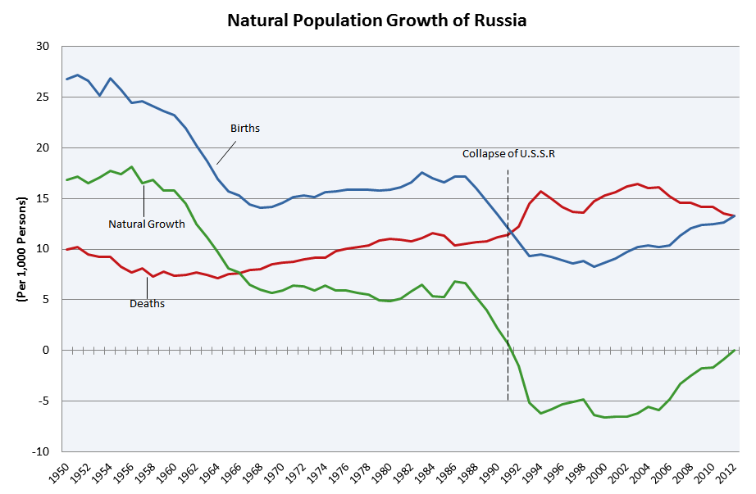
At what point did Russia’s population begin to decrease drastically? Increase again?

Slide 84
Predict: What might be the results of having too few people in your country?

Slide 85
Discuss: If you were Russia’s leader, what policies might you put in place to increase population?

Slide 86
Russia’s Population Policies (2006)
Cash Incentives for Children
The “Day of Conception”
Immigration Incentives
Notes:
In 2006, Vladimir Putin, in his state of the union speech began new policies to increase Russia’s population.

Slide 87
A Case for an Restrictive Population Policy: The People’s Republic of China

Slide 88
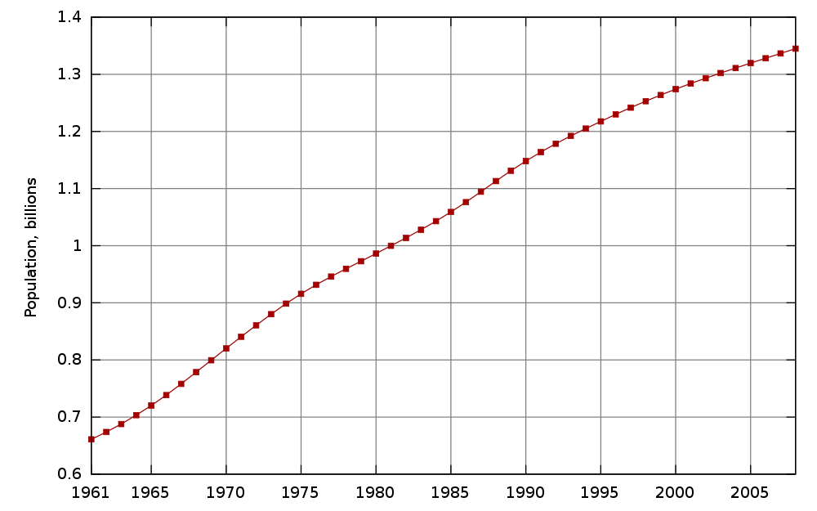
Compare China’s population growth to that of Russia.

Slide 89
China’s One Child Policy
Benefits Given to Families with 1 Child
A fine imposed for additional children
More successful in Urban areas

Slide 90
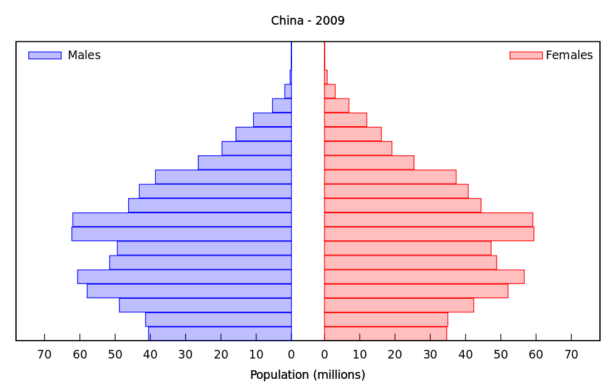
Would you consider the One Child Policy effective? Why or Why not?

Slide 91
Predict: What might be the results of limiting population growth?

Slide 92
Part 2: Migration

Slide 93
Sections
Types of Migration
Reasons for Migration
Where do people migrate?

Slide 94
Section 1: Types of Migration

Slide 95
Types of Movement
Cyclic
Involves a journey that begins at our home and brings us back to it.
These movements create activity spaces: which are spaces of daily routines.
Periodic
Periodic movement involves a longer period of time away from home.
In transhumance, the periodic movement based on the seasons.
Migration
Permanent relocation.
International (Transnational) Migration – Movement across country borders.
Examples: Commuting to Work or School, Vacations, Etc.
Examples: Migrant labor, Out-of-State College, Military Service
Internal (Domestic) Migration – Movement within a country borders.
Intraregional and Intraregional Migration

Slide 96
The next seven slides will ask you to identify what type of movement is occurring.

Slide 97
Travelling to school each day.

Slide 98
A rancher moving his herd from season to season.

Slide 99
Taking a vacation in the summer.

Slide 100
Permanently moving from one state to another.

Slide 101
Attending college in another city within your state.

Slide 102
Attending an out-of-state college.

Slide 103
Moving to Djibouti in Africa.

Slide 104
What is the difference between emigration and immigration?

Slide 105
“Immigration is migration to a location, emigration is migration from a location.”

Slide 106
Section 2: Reasons for Migration

Slide 107
Forced Migration

Slide 108
What is forced migration?

Slide 109
“Forced Migration occurs when someone is involuntarily caused to migrate against their own choice.”

Slide 110
What are some examples of forced migration?.

Slide 111
Examples of Forced Migration
The Atlantic Slave Trade
British relocation of prisoners to Australia
US relocation of Native Americans
Forced Counter-migration back to a country of origin.

Slide 112
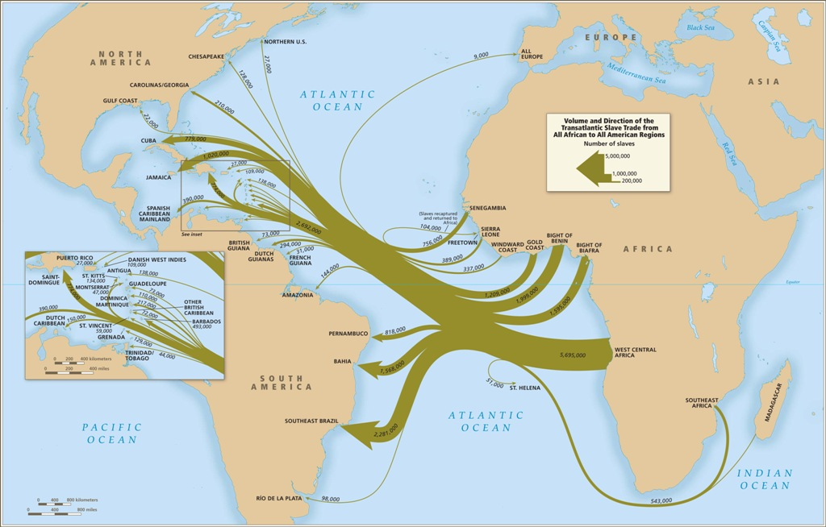
Which country received the most African Slaves?

Slide 113
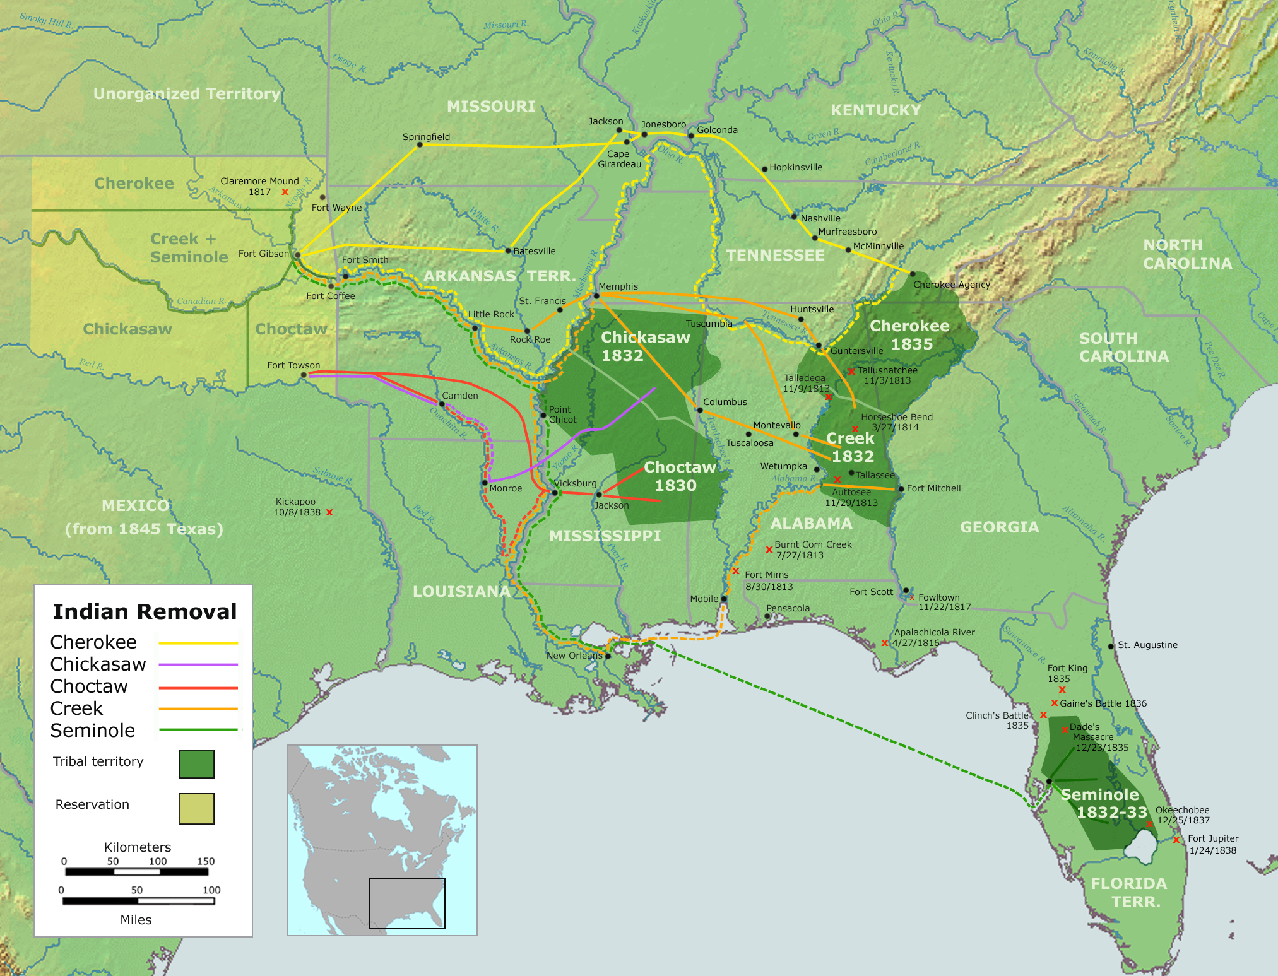
What kind of land were the Native Americans being forced to migrate to?

Slide 114
What is a refugee?

Slide 115
A refugee is a person leaves their home because they are forced out but not because they are officially relocated or enslaved.

Slide 116
A refugee emigrates because of:
Fears of Persecution
Race
Religion
Nationality
Social Group Membership
Political Opinions
Fears of Circumstance
War
Natural Disasters
Famine

Slide 117
Would Cuban-Americans be considered refugees?

Slide 118
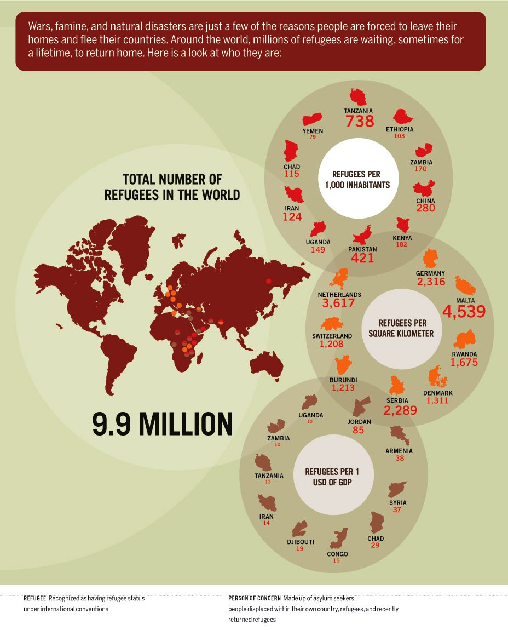
Why are there no noticeable refugee populations in the United States?

Slide 119
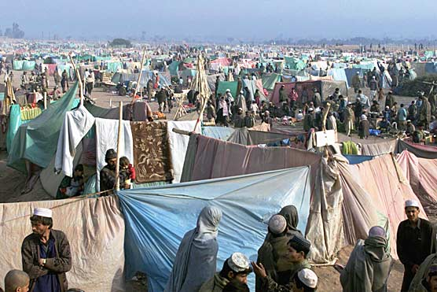
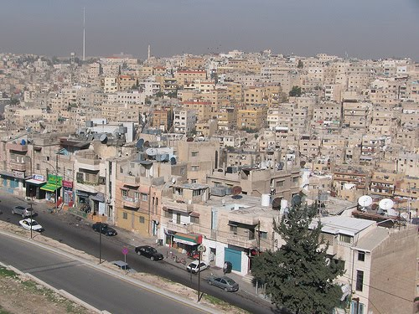
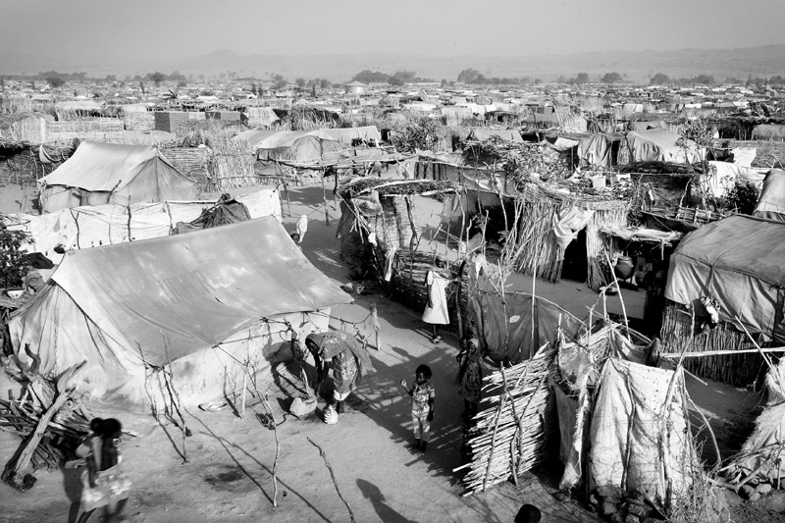
Images from three different refugee camps.

Slide 120
Voluntary Migration

Slide 121
Why do people choose to migrate from one place to another?

Slide 122
“I developed 11 laws of migration. These laws examine the reasons for migration, the distance of migration, and the characteristics of migrants.”
E.G. Ravenstein

Slide 123
Ravenstein’s Laws
Every migration flow generates a return or counter-migration.
The majority of migrants move a short distance.
Migrants who move longer distances tend to choose big-city destinations.
Urban residents are less migratory than inhabitants of rural areas.
Families are less likely to make international moves than young adults.
Most migration occurs because of economics and increases with economic development.
Women migrate more than men intraregionally, men more than women internationally .
Migration occurs in steps.

Slide 124
Other Characteristics of Migrants:
Most long-distance migrants are adults.
40% are Young Adults
Only 5% are over 65.
People with higher levels of education are more likely to make longer moves.
People who have friends or relatives who have migrated to other areas are more likely to migrate.

Slide 125
What is step migration?

Slide 126
“Step Migration is the phenomenon in which long distance migration happens in stages. ”
Notes:
Examples of step migration?

Slide 127
What is chain-migration?

Slide 128
“Chain Migration occurs when one group from a location follows another group from that location later on. ”
Notes:
Examples of step migration?

Slide 129
What is an intervening obstacle and opportunity?

Slide 130
“An intervening obstacle is a problem that hinders a complete migration path. An intervening opportunity is an opportunity that causes someone to settle before reaching their original destination”

Slide 131
What would be an example of an intervening opportunity? An intervening obstacle?

Slide 132
Which of the following would be most likely to occur. Explain.
A Chinese family moves from their home in Beijing to a small town in Idaho.
b) An American male college student moves
from his small Louisiana town to Los Angeles
for school.
c) A female college professor and her son moves
from London, England to a town in
Afghanistan.

Slide 133
Push Factors
Pull Factors
Factors that cause a person to leave an area.
Factors that cause a person to be drawn to an area.

Slide 134
Types of Push and Pull Factors:
Political Issues
Armed Conflict
Oppressive Governments
Economic Issues
Job Opportunities
Cost of Living
Environmental Issues
Crime/Pollution/Traffic Problems
Weather
Cultural Issues
Transportation Issues
Growth and Recession
Returning to homeland
Moving with a family
Improved transportation allows people to move to new places.

Slide 135
Section 3: Where do people migrate?

Slide 136
World Migration

Slide 137
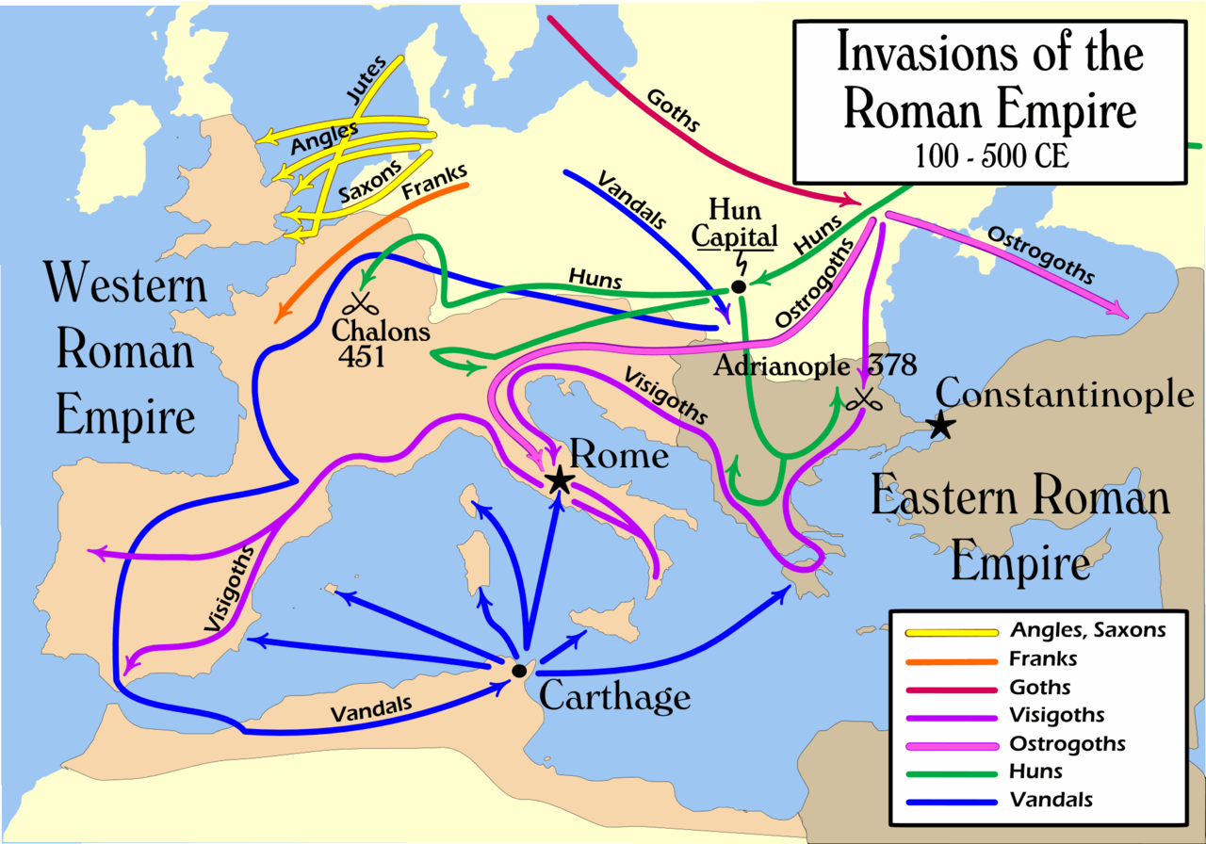
Early Migration Patterns

Slide 138
Modern Migration Time-Line
Before 1500
Global scale migration occurred haphazardly.
1500s- 1800s
European Colonization of the America’s, Coast of Africa, and parts of Asia
1800s – 1900s
European Colonization of interior Africa and Asia
It was largely dependent on spices, fame, or exploration.
1900s-Present
World War I and II motivated migration
The 1947 Partition of Pakistan/India motivated large religious migration back and forth.

Slide 139
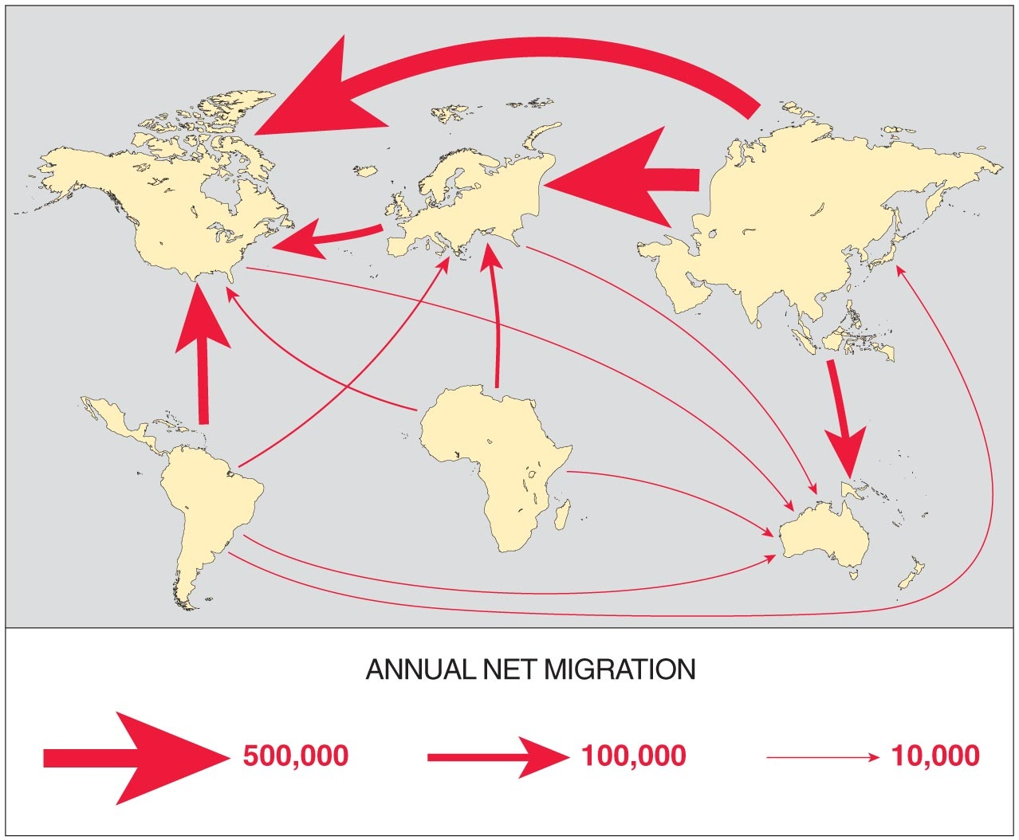
What current migration patterns are visible from the above map?

Slide 140
Current Migration Patterns
Asia, Latin America, Africa have a net out-migration.
North America Europe and Oceana have a net in-migration
Asia often migrates to Europe and North America
South America often migrates to North America
Africa often migrates to Europe

Slide 141
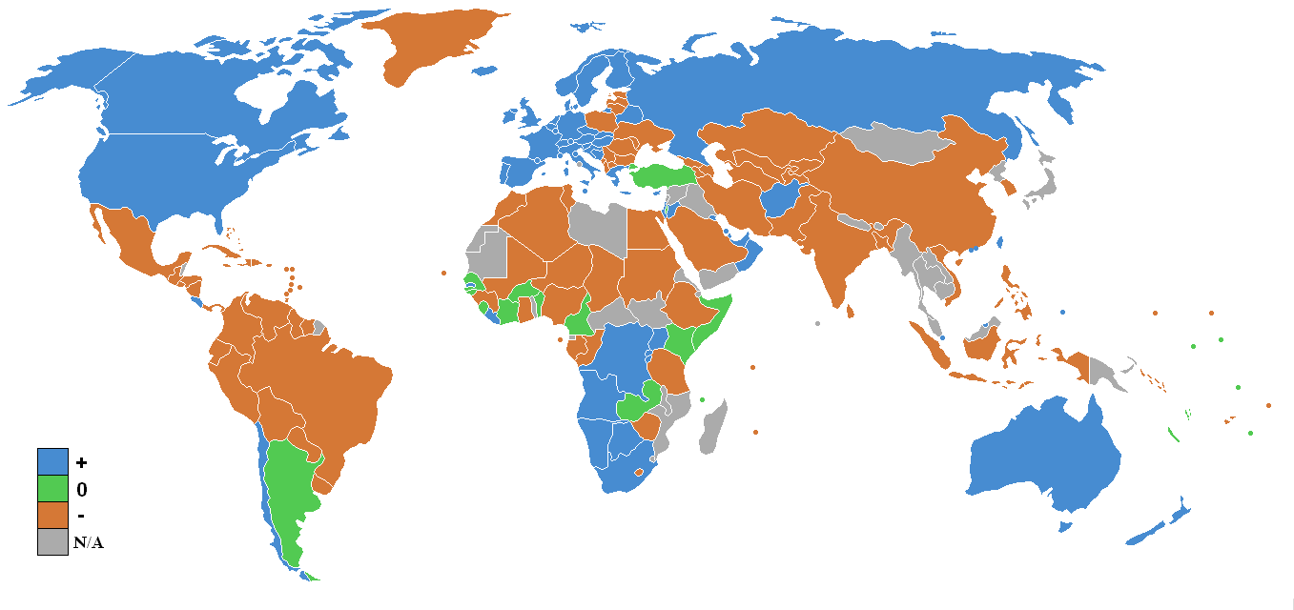
Analyze the Immigration/Emigration map above. What questions could you answer using this map?

Slide 142
United States Migration

Slide 143
US Immigration Timeline:
Colonial Settlement (Prior to 1776)
European Emigration (19th and Early 20th Century)
1840s-50s Irish escaping economic conditions and Germans escaping political conditions.
Most migrants from Great Britain.
African Slaves
Late 1800s – The Industrial Revolution drew Germans, Irish, and Scandinavians
Early 1900s-Italy, Russia, Austria/Hungary came looking for fortune.
Since 1945
After American law was changed, China, Philippines, India, Vietnam, and Latin America began to immigrate in large numbers.

Slide 144
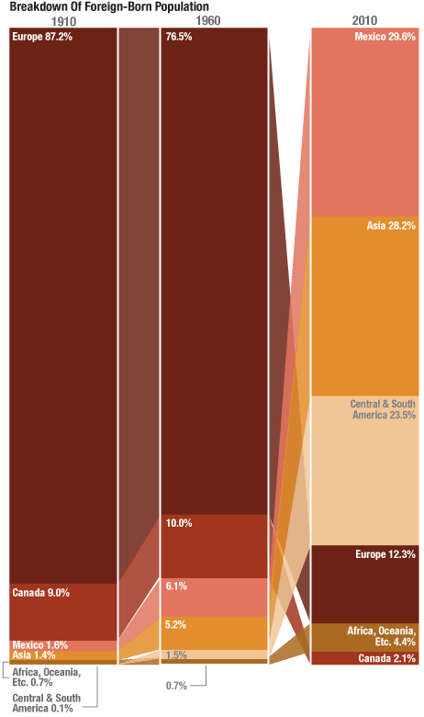
How has US Immigration changed since 1910?

Slide 145
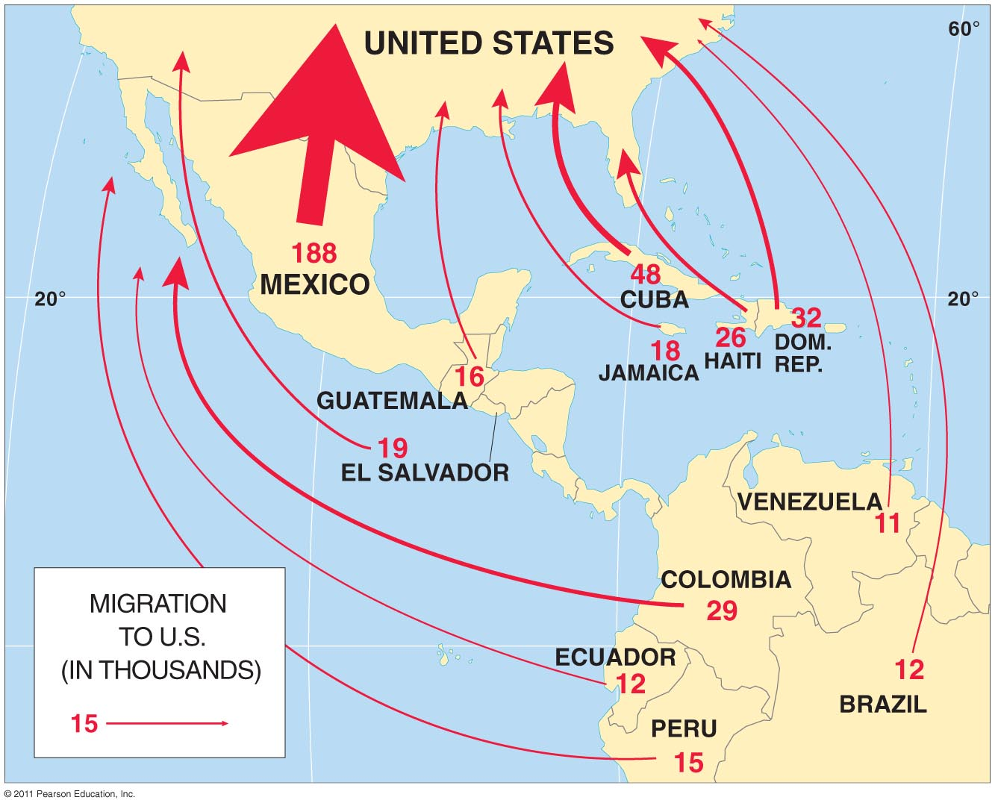
Which of Ravenstein’s laws can you see by looking at this map?

Slide 146
US Internal Migration Patterns

Slide 147
US Internal Immigration Timeline:
Colonial Settlement
Early 1800s
Interior Settlement spurred by the building of canals and low priced land between the Appalachians and the Mississippi.
Mostly Coastal Locations.
1840s - 90s
The gold rush prompts quick migration to California – bypassing the Great Plains area.
1890s – 1940s
Americans begin moving to the Great Plains region for cheap land.
1940s – Present
Increasing Southern Migration

Slide 148
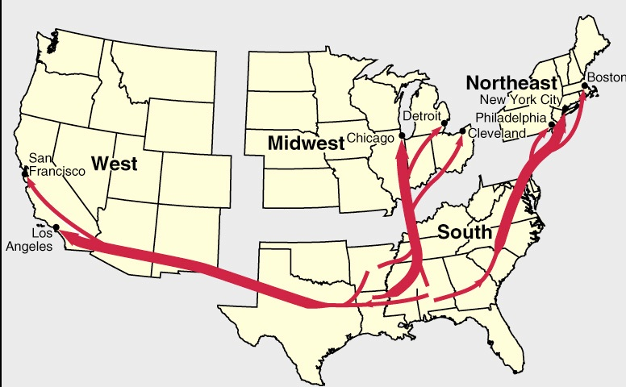
In the early twentieth century, African Americans began moving from the rural south to large cities in the Northeast, Midwest, and West. Why did this occur?

Slide 149
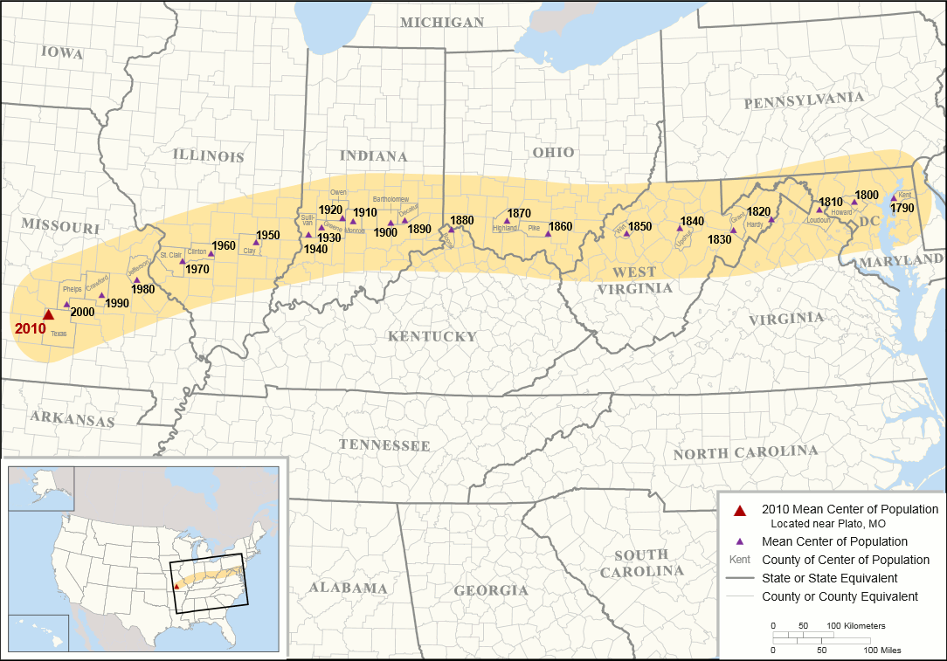
Center of US Population
Describe the movement of the center of US population from 1790 to 2000.

Slide 150
End of Unit 2

